Slide 1
Relative Vectoring
Using Dual Object Detection

Slide 2
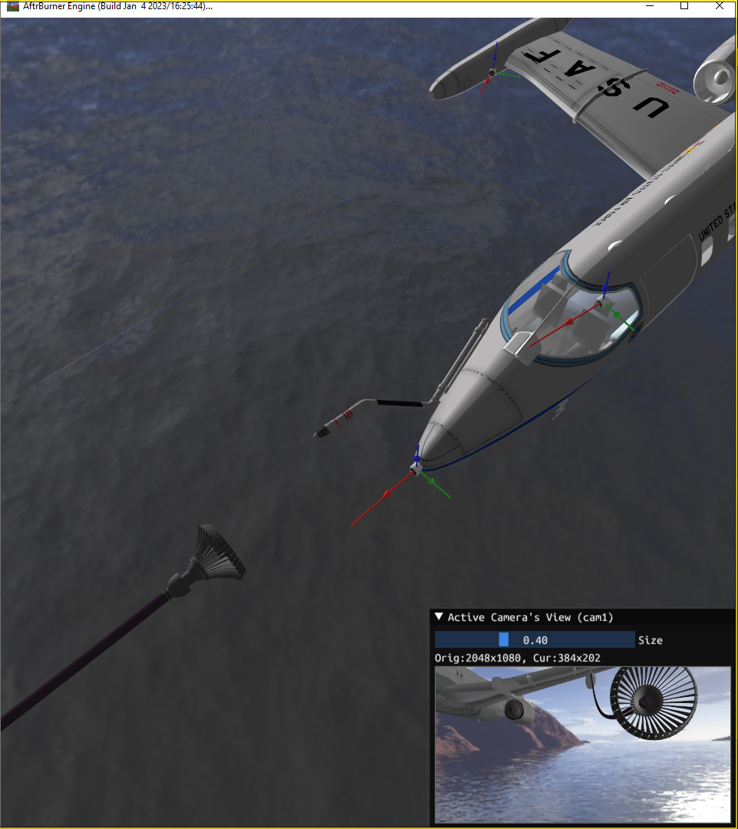
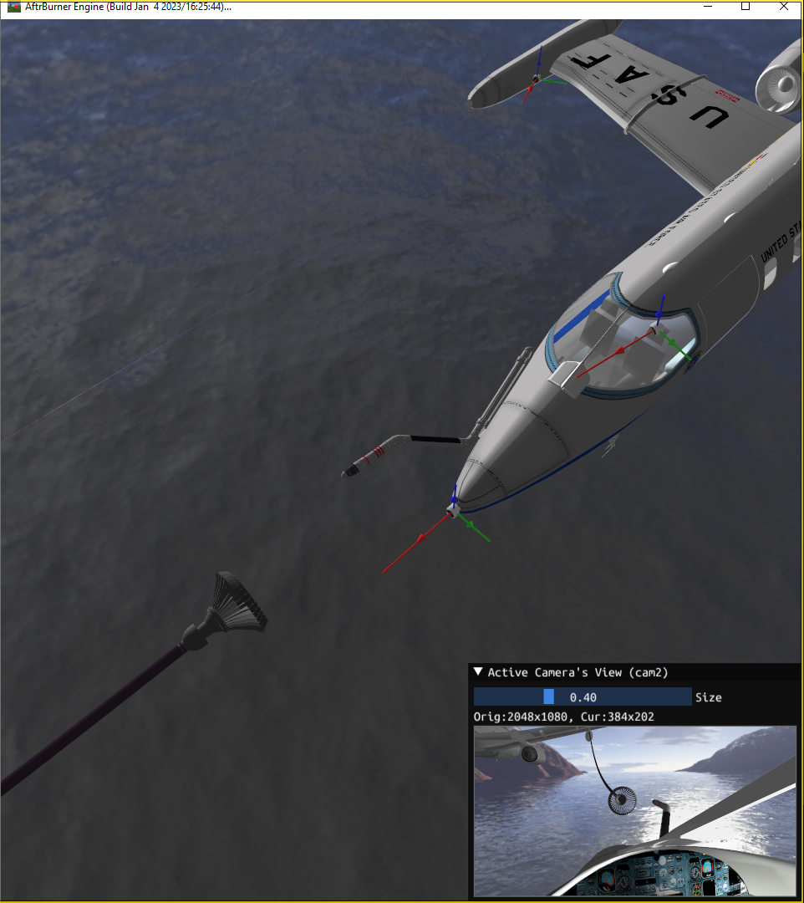
Current methods
Proposed method
camera-to-probe
probe offset
probe-to-drogue
probe-to-drogue
camera-to-drogue
camera-to-drogue

Slide 3
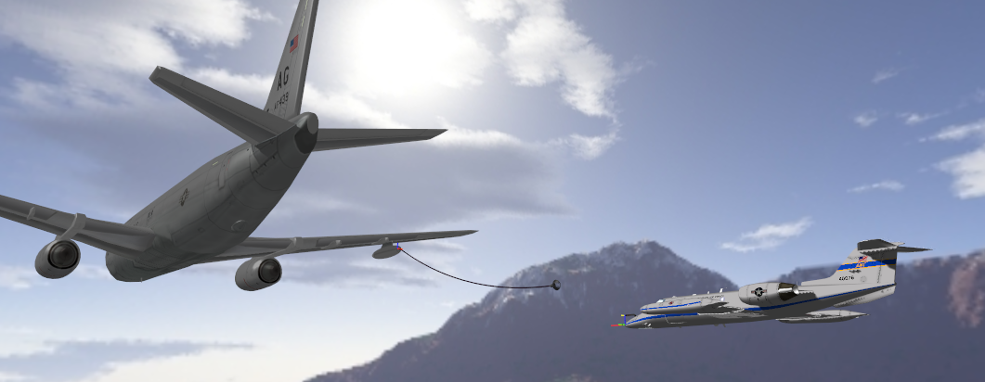
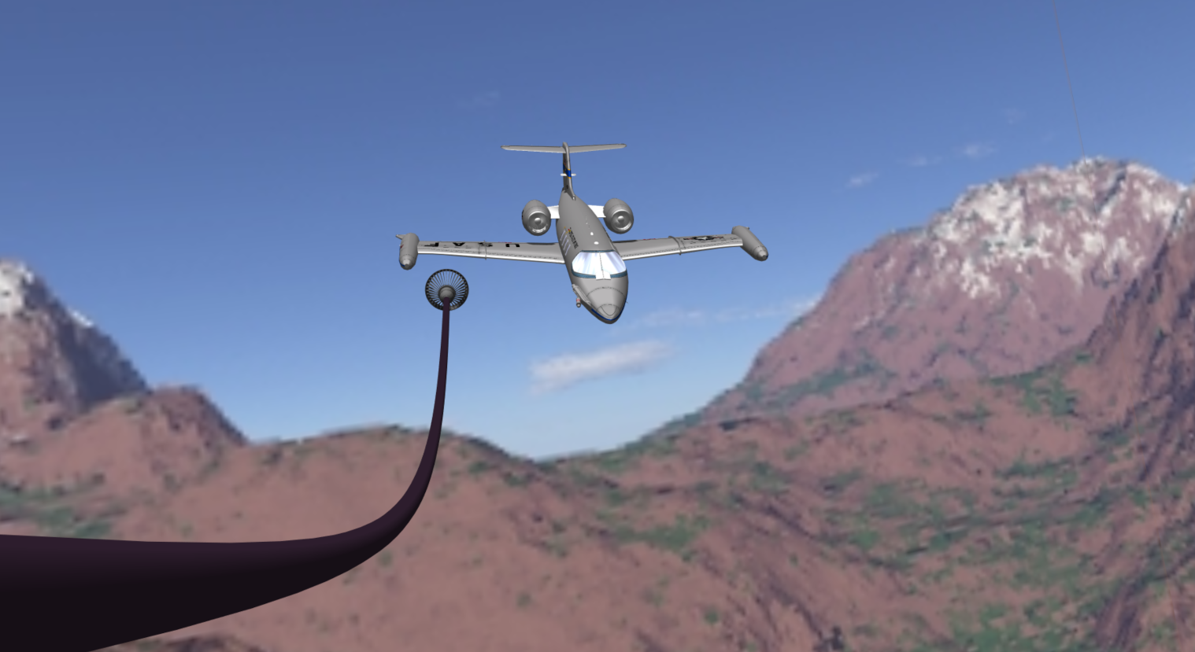
Rear facing
camera
1
Capture image
Image
2
Find 2D points
receiver
points
2D points
3
Match 2D to
3D points
drogue matches
(u₀, v₀) <-> (x₀, y₀, z₀)
(u₁, v₁) <-> (x₁, y₁, z₁)
(u₂, v₂) <-> (x₂, y₂, z₂)
…
(u_{m}, v_{m}) <-> (x_{m}, y_{m}, z_{m})
drogue
points
receiver matches
(u₀, v₀) <-> (x₀, y₀, z₀)
(u₁, v₁) <-> (x₁, y₁, z₁)
(u₂, v₂) <-> (x₂, y₂, z₂)
…
(u_{n}, v_{n}) <-> (x_{n}, y_{n}, z_{n})
Matches
4
Transform matches
into poses (SolvePnP)
Poses
5
Transform poses
into PtD vector
drogue
pose
receiver
pose
PtD vector
Autonomous agents pilot the aircraft
PtD vector

Slide 4


Dual Object Detection
Camera Instrinsics
(from calibration)
Object 1 & 2 3D points
(models known a priori)
Image of
2 objects
Object 1
2D points
[R|t]_{Obj1}
[R|t]_{Obj2}
Camera
YOLO
Solve
PnP
Vector
Trans.
relative nav.
vector
Object 2
2D points

Slide 5
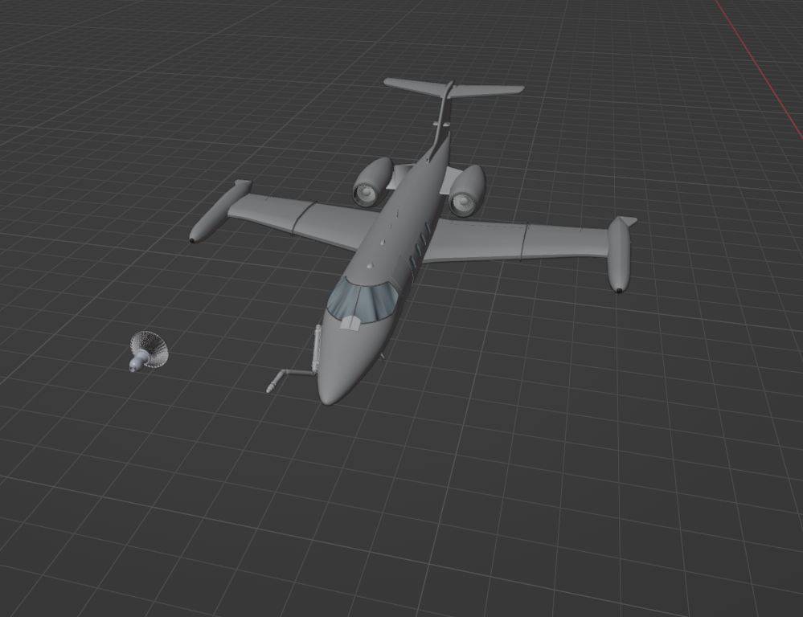
2D pts
2D pts
ID
ID
3D pts
3D pts
(u₁, v₁)
(u₂, v₂)
(u₃, v₃)
(u₄, v₄)
(u₅, v₅)
(u₁, v₁)
(u₂, v₂)
(u₃, v₃)
(u₄, v₄)
(u₅, v₅)
p1
p2
p3
p4
p5
p1
p2
p3
p4
p5
(x₁, y₁, z₁)
(x₂, y₂, z₂)
(x₃, y₃, z₃)
(x₄, y₄, z₄)
(x₅, y₅, z₅)
(x₁, y₁, z₁)
(x₂, y₂, z₂)
(x₃, y₃, z₃)
(x₄, y₄, z₄)
(x₅, y₅, z₅)
p2
p1
(u₆, v₆)
(u₇, v₇)
(u₈, v₈)
(u₉, v₉)
(u₆, v₆)
(u₇, v₇)
(u₈, v₈)
(u₉, v₉)
d1
d2
d3
d4
d1
d2
d3
d4
(x₆, y₆, z₆)
(x₇, y₇, z₇)
(x₈, y₈, z₈)
(x₉, y₉, z₉)
(x₆, y₆, z₆)
(x₇, y₇, z₇)
(x₈, y₈, z₈)
(x₉, y₉, z₉)
d1
p4
d2
d4
d3
p3
[R_{d}, t_{d}]
p5
model points
(u, v)
p2
p1
d1
d2
d4
d3
p5
p3
p4
YOLO
predictions
[R_{p}, t_{p}]
camera pose

Slide 6
ꓕ
PtD vector =
R_{p}(t_{d} - t_{p})
t_{d} - t_{p}
drogue pose
t_{d} - t_{p}
receiver pose
t_{d}
t_{p}
camera pose

Slide 7
Bounding box corrections
Corrected
bounding box
2Δy
Occluded
feature points
Sensed
feature points
True
3D center
Δy
Original
center
Δx
Original
bounding box
2Δx

Slide 8
Simulation Results

Slide 9
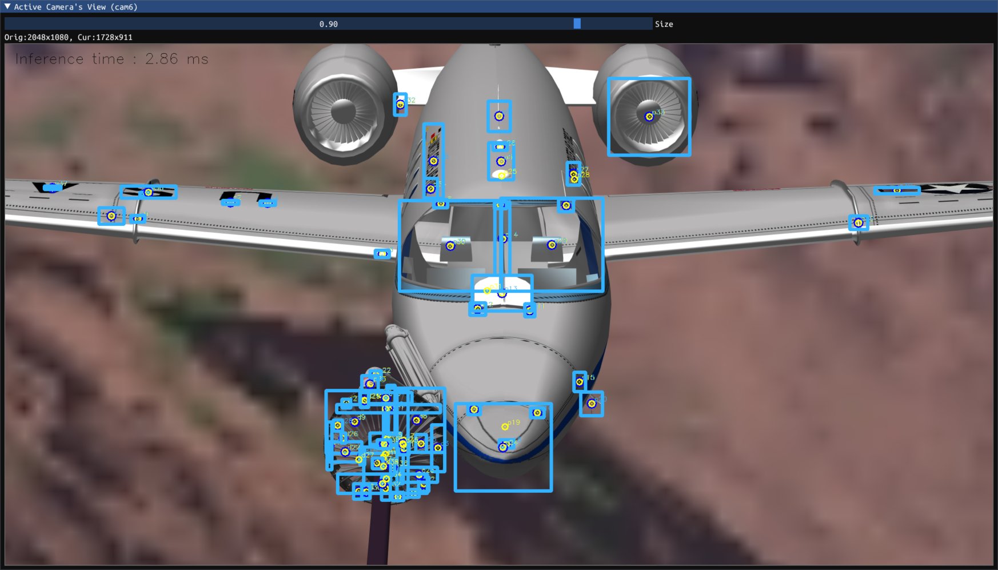
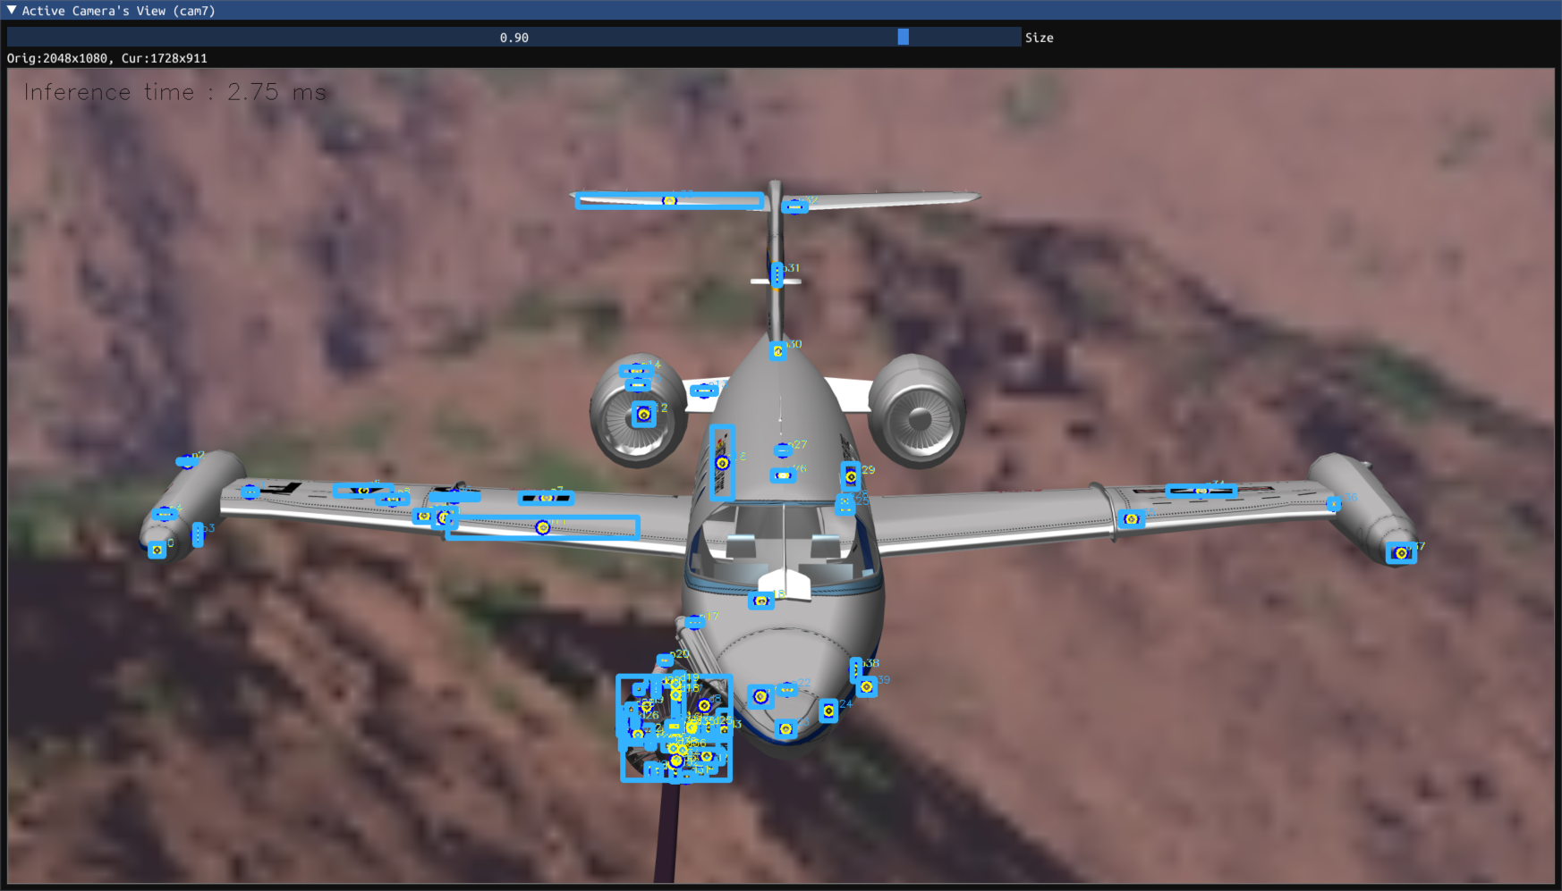
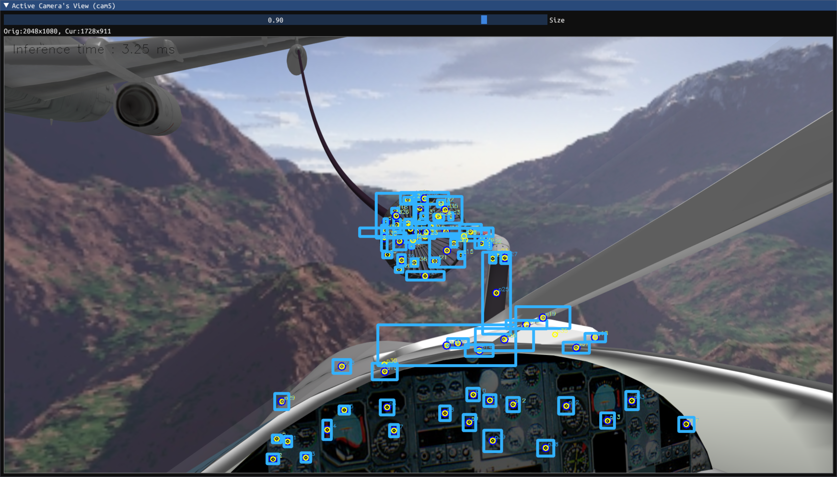
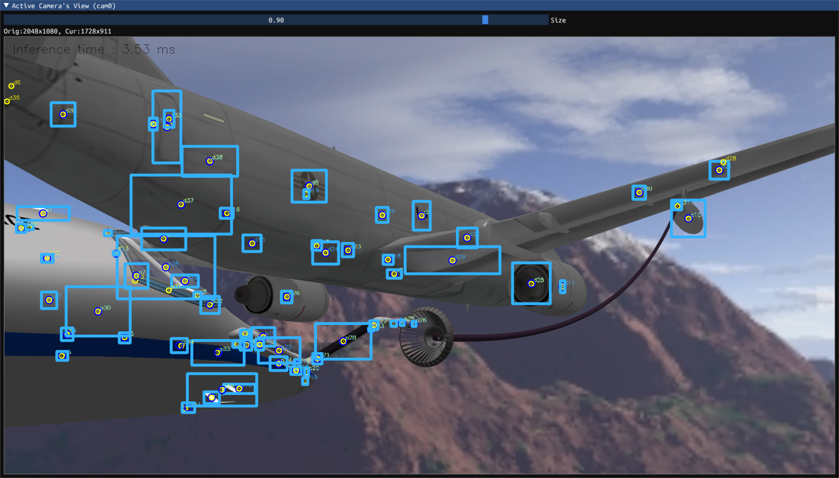

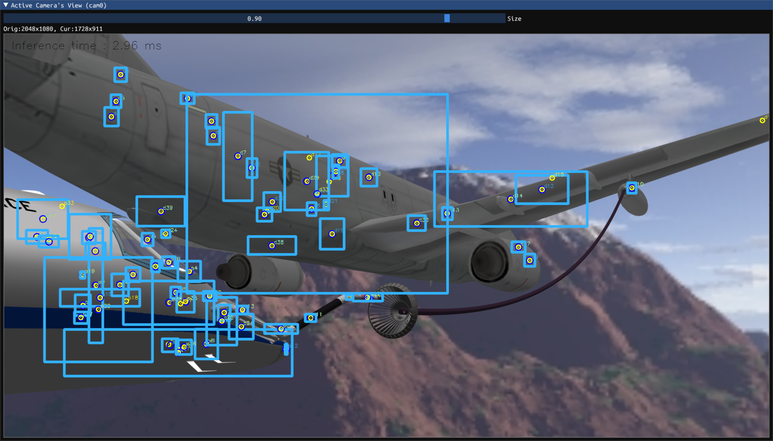
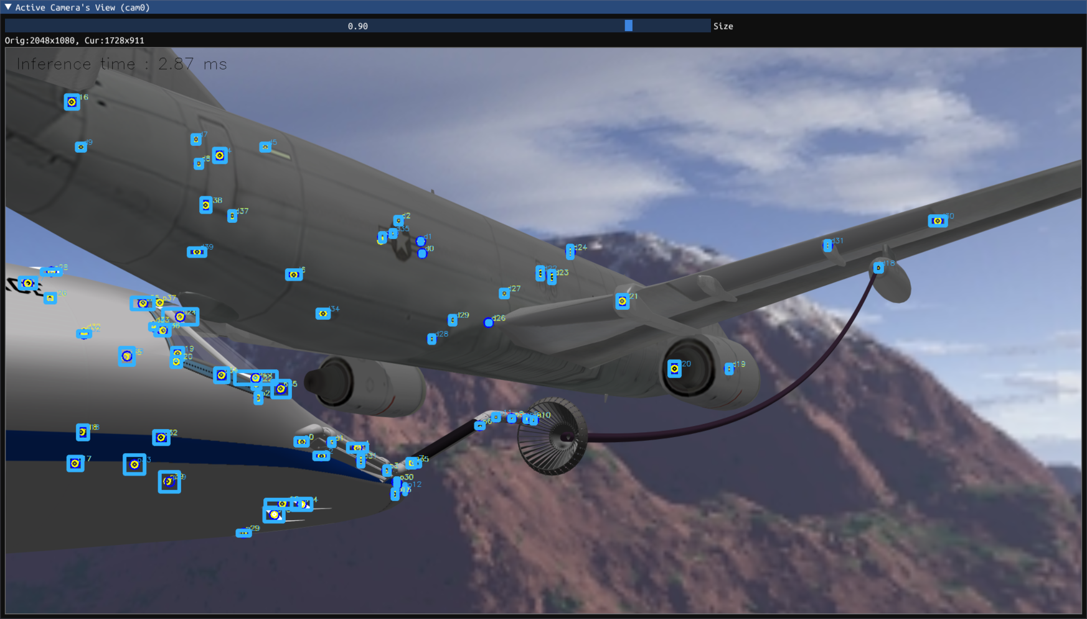
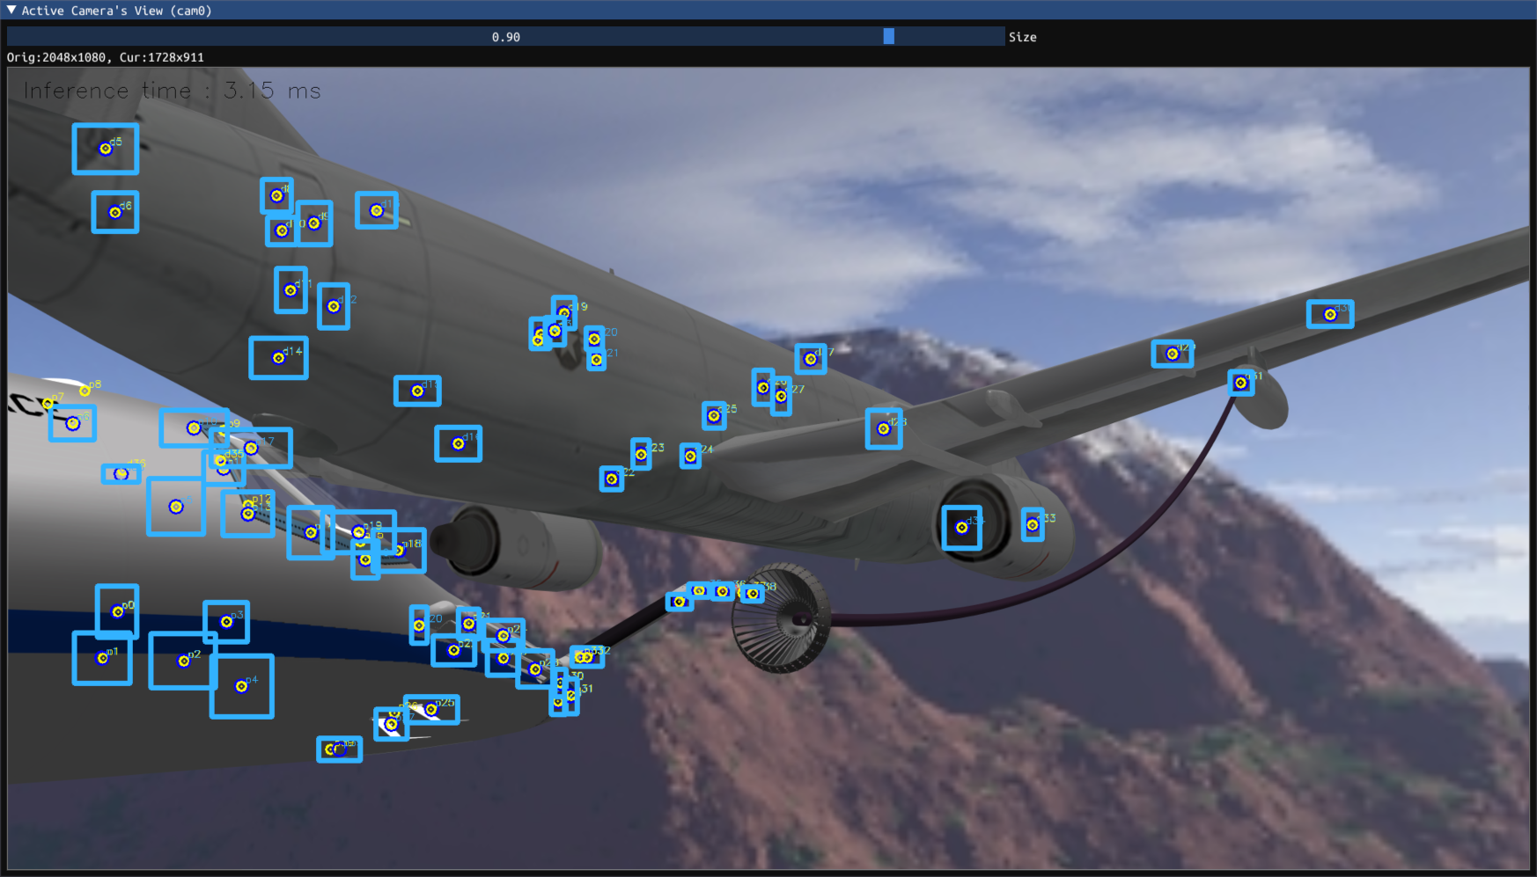
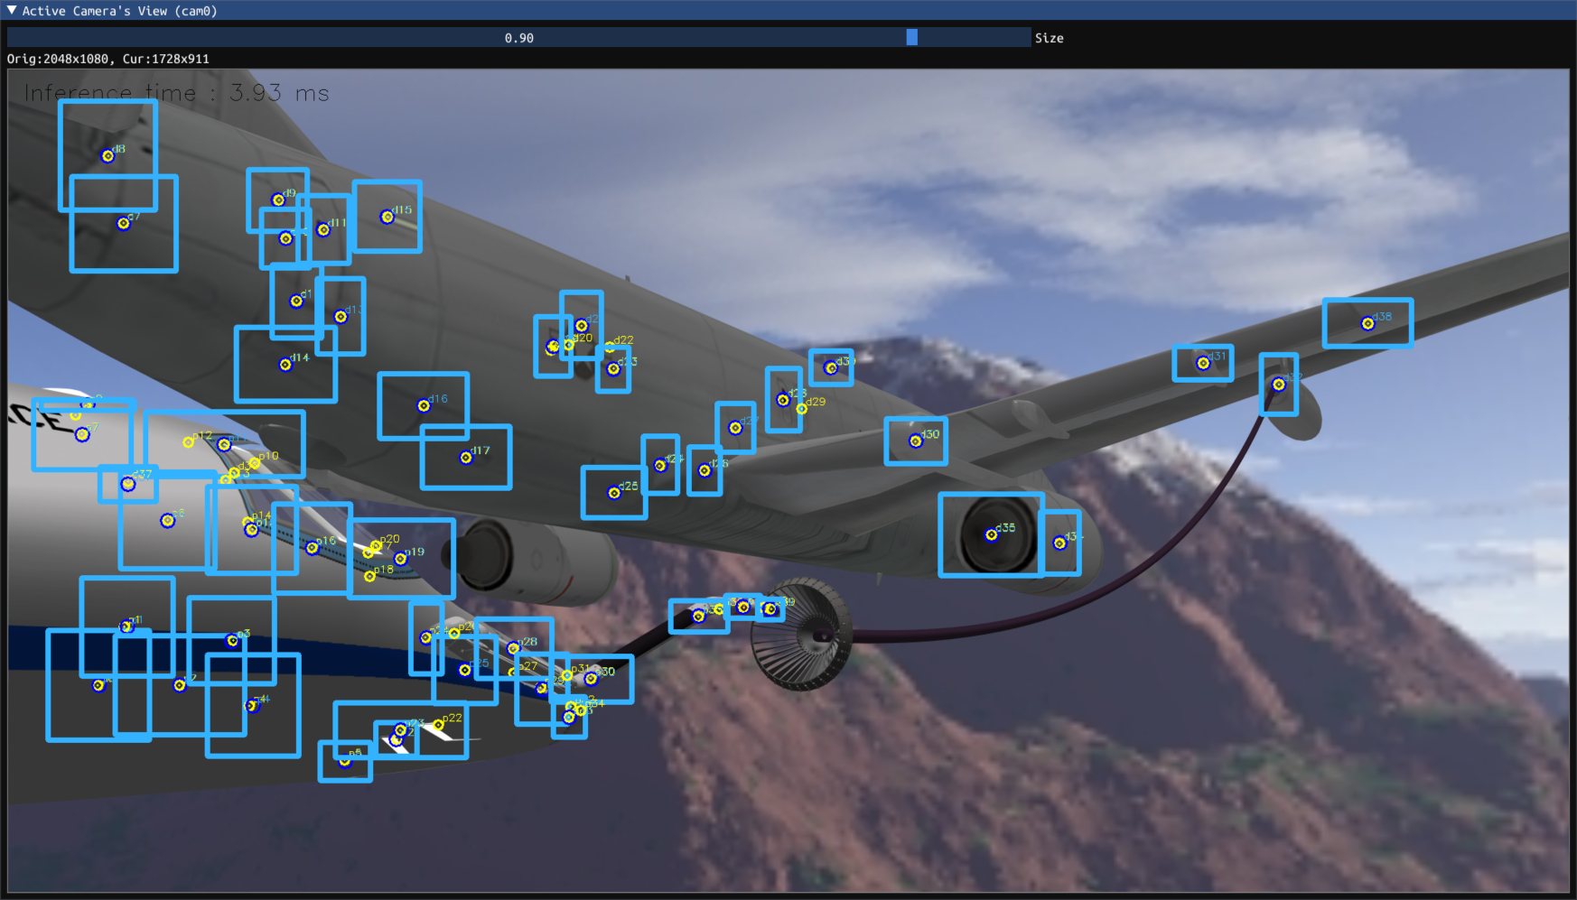
podcam1 (zoomed in)
podcam2 (zoomed out)
dashcam
d12
d13
corrected bounding boxes
uncorrected bounding boxes
random features
small features
medium features
large features

Slide 10
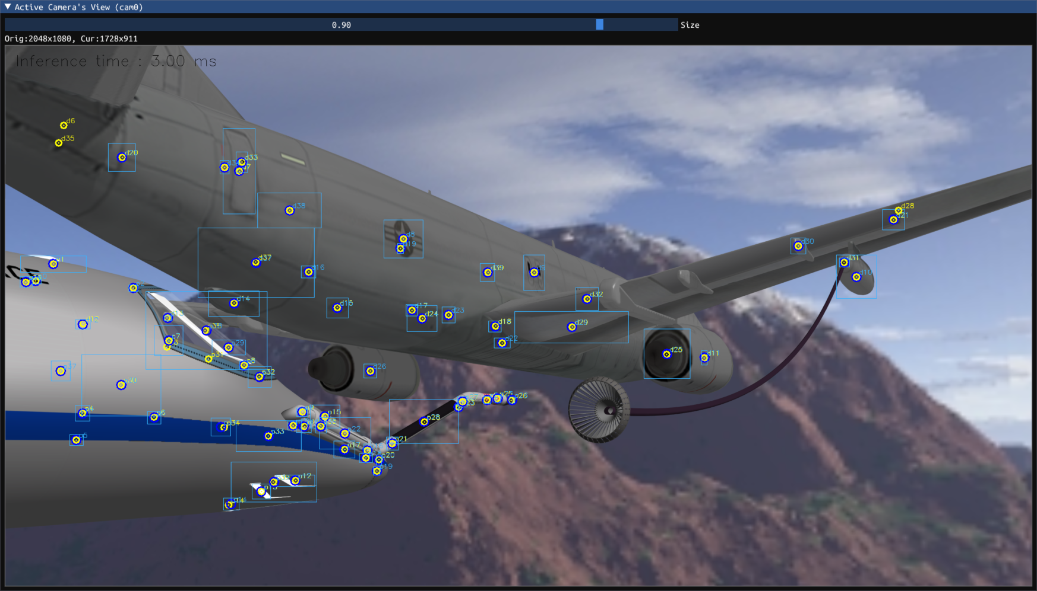
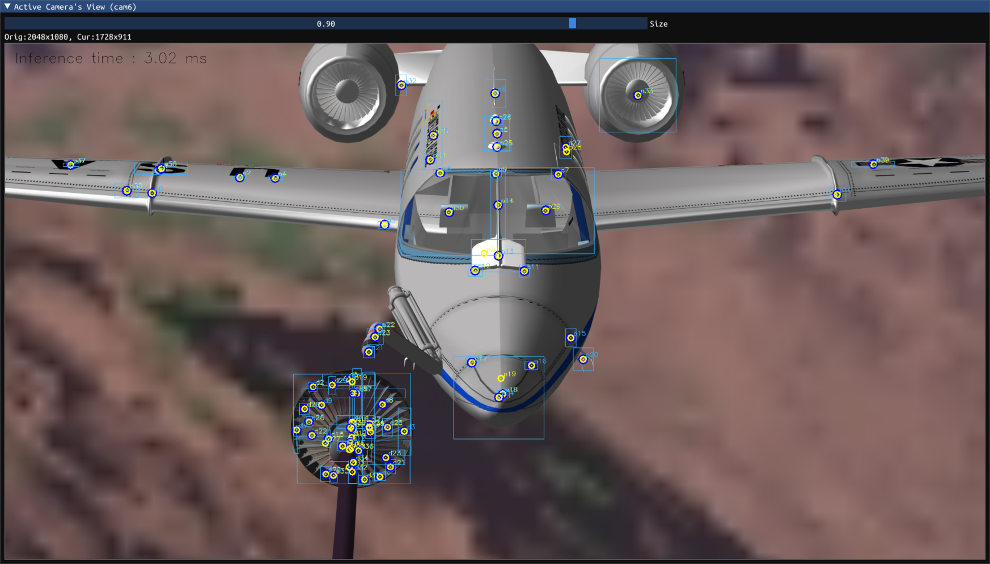
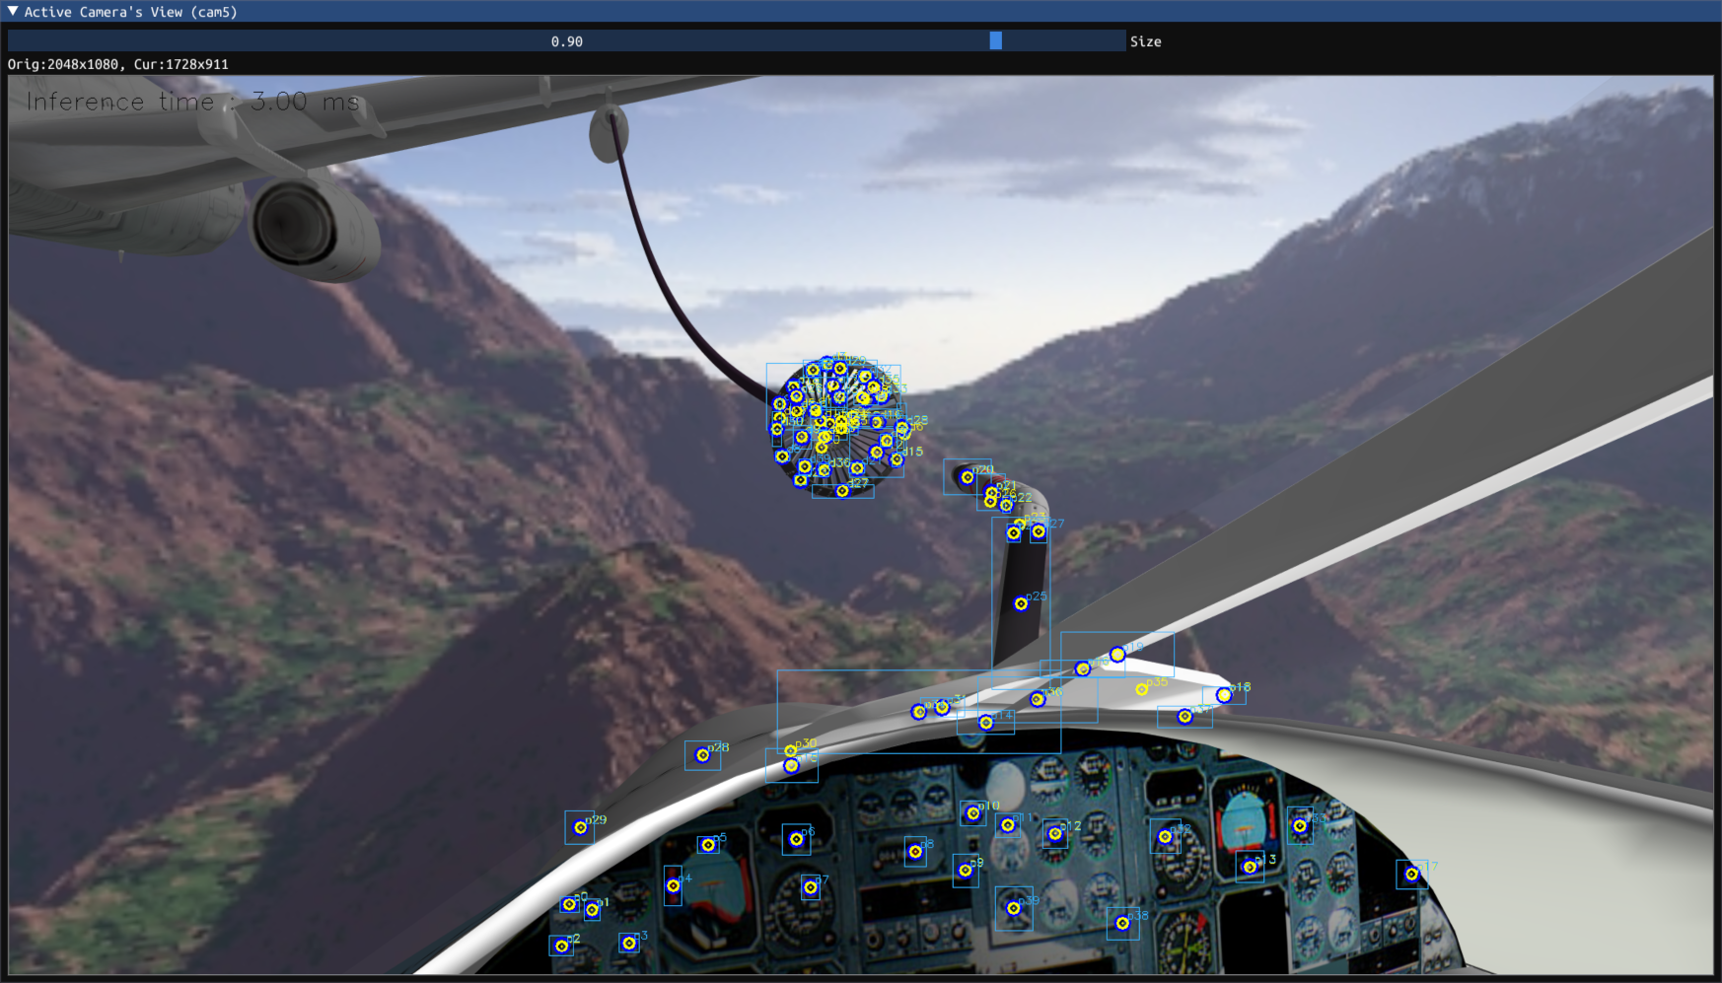
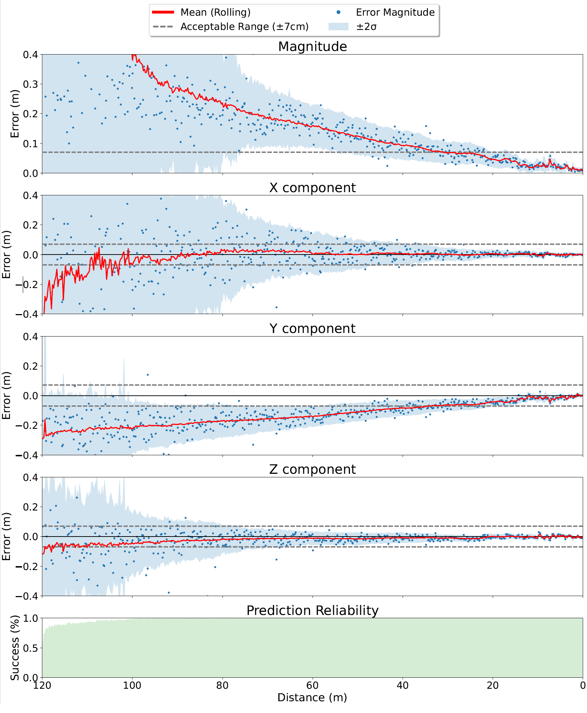
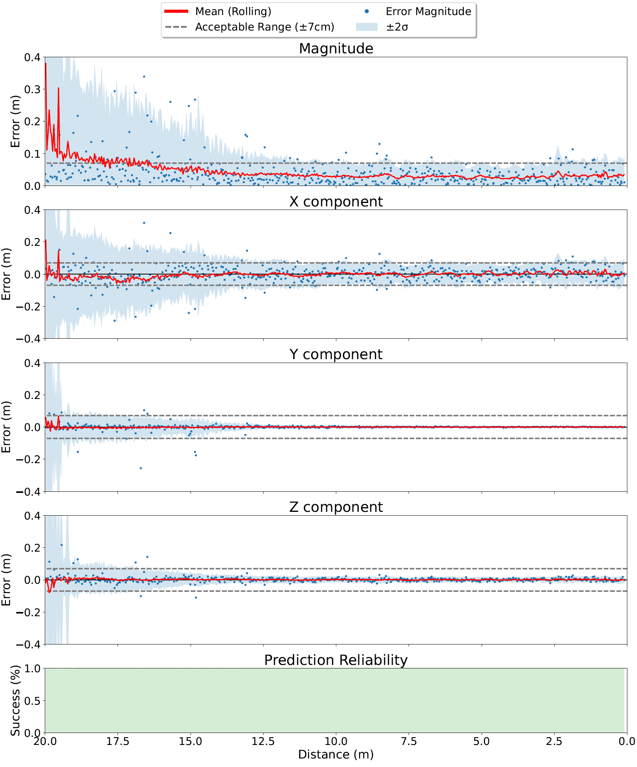
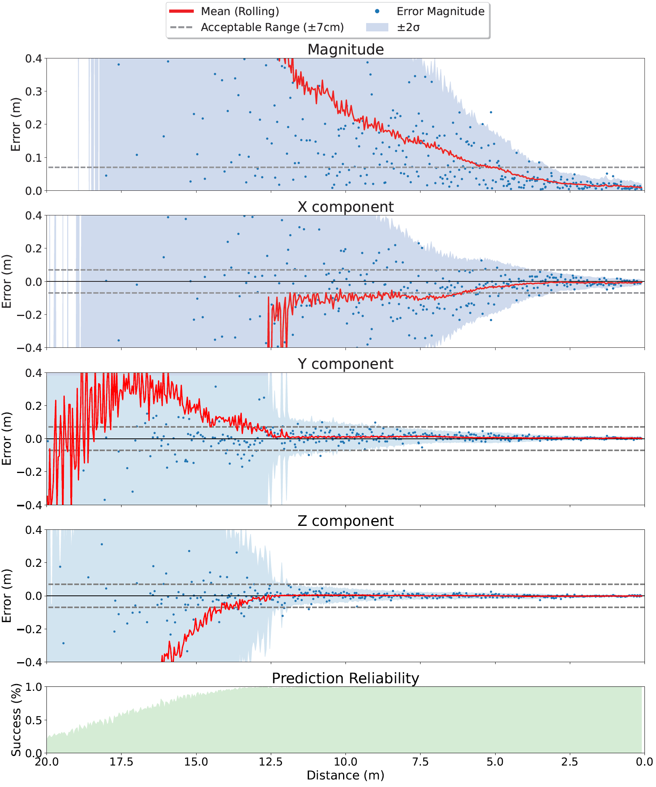
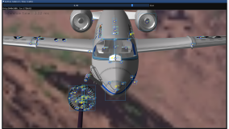

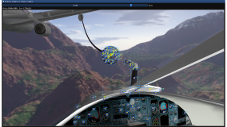
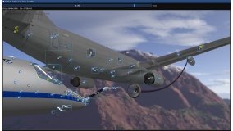
wingcam
podcam (zoomed in)
dashcam

